Slide 1
Employee Data Analysis using Excel
STUDENT NAME: Salma.S
REGISTER NO : 2213331042061
DEPARTMENT : Commerce
COLLEGE : Bharathi Women's college

Slide 2
PROJECT TITLE
EMPLOYEE SALARY ANALYSIS

Slide 3


AGENDA
Problem Statement
Project Overview
End Users
Our Solution and Proposition
Dataset Description
Modelling Approach
Results and Discussion
Conclusion
3/21/2024 Annual Review

Slide 4

PROBLEM STATEMENT
The complexity of the analysis and its repetitive nature can make it difficult to ensure proper process monitoring and reporting without professional solutions.

Slide 5

PROJECT OVERVIEW
A salary analysis, or compensation analysis, is a project that compares an organization's compensation packages to market rates to determine if salary adjustments are needed. It can also help ensure that compensation is fair and equitable across all roles.

Slide 6

WHO ARE THE END USERS?
A salaried employee is entitled to various benefits and perks, though they are not qualified for overtime pay or minimum wages. The main advantage of salaried employees is that they have more opportunities to enhance their career and receive various benefits like paid time off, health plans, vacations,

Slide 7

OUR SOLUTION AND ITS VALUE PROPOSITION
The employee value proposition (EVP) is rapidly gaining importance in organizations as it plays a key role in attracting, engaging, and retaining top talent and elevating your entire employer brand. But what exactly is EVP, and how can you develop a compelling employee

Slide 8
Dataset Description
a dataset might contain a collection of business data (sales figures, customer contact information, transactions, etc.). A dataset can include many different types of data, from numerical values to text, images or audio recordings.

Slide 9

THE "WOW" IN OUR SOLUTION
Have you ever had one of those moments as a customer where your brain felt like exploding, and you were so mindblown by an amazing service that all you could think was 'WOW'? Today I will be discussing these moments. I will be talking about:
3/21/2024 Annual Review
9

Slide 10
MODELLING
An Introduction to Project Modeling and Planning (Springer Texts in Business and Economics) Offers a comprehensive introduction to project management, focusing on project planning and control, with an emphasis on mathematical modeling Highlights theoretical concepts and models with detailed explanations, application examples and case studies based on real life problems Includes exercises at the end of each chapter, as well as PowerPoint slides for in-class lectures or as a guide for self-study
10

Slide 11
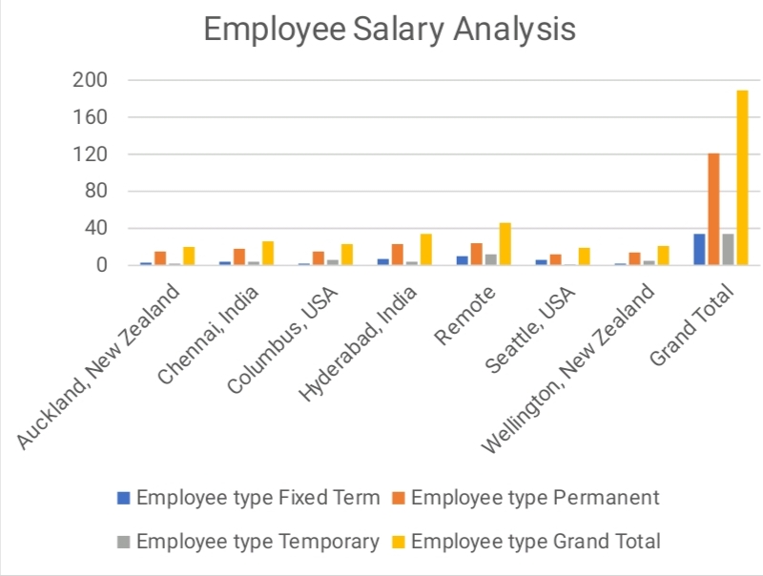
RESULTS
11

Slide 12
conclusion
Skill development programs These programs can help develop a skilled workforce, reduce youth unemployment, and promote economic growth. Organizational justice This is how an employee perceives and judges their employer's treatment in terms of fairness and justice.

